Slide 1
ASSESSING AND MINIMIZING PEDESTIRANS’ EXPOSURE TO TRAFFIC NOISE WITH SPATIAL ANALYSIS AND WEB GIS:
-
Working title
Preliminary methods & results
Joose Helle

Slide 2
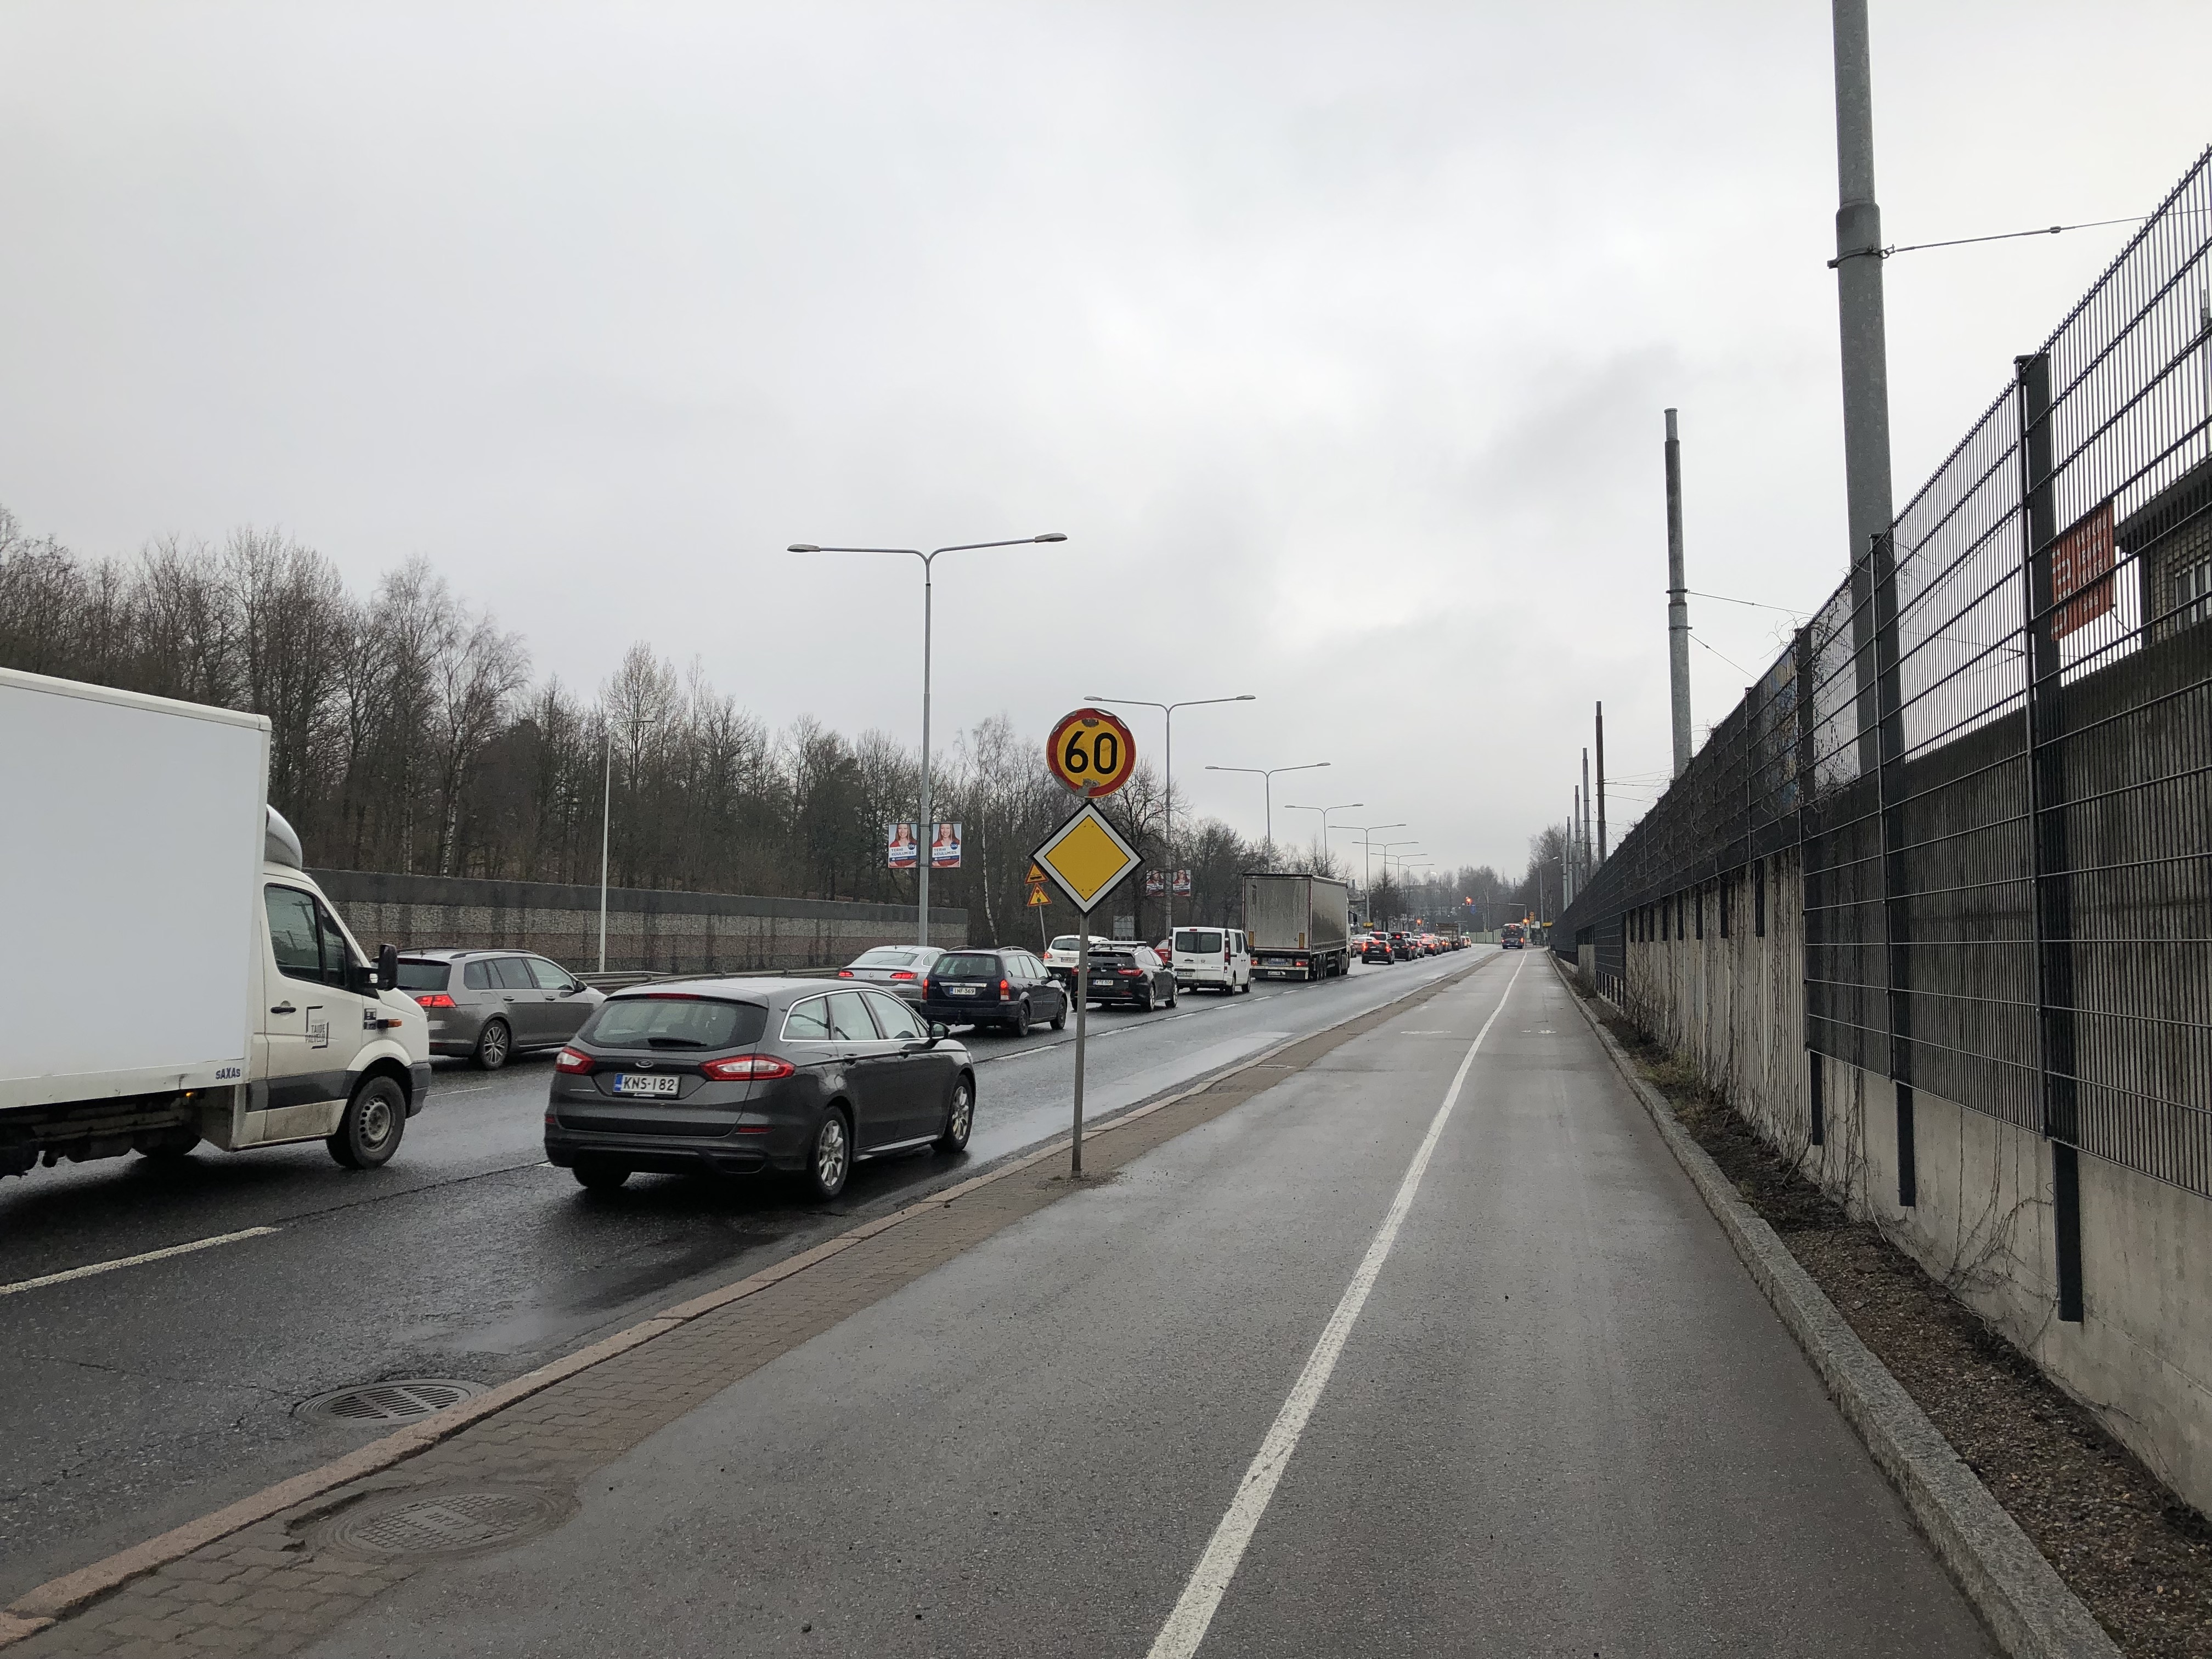
QUIET PATH OPTIMIZATION

Slide 3
QUIET PATH OPTIMIZATION
Shortest path is not always the least cost path
Dijkstra’s algorithm for route optimization
Utilizes graph theory: nodes connected by edges
Finds the least cost path between two nodes by edge costs
If edge cost = length => least cost path = shortest path
However, edge cost can be any (numeric) attribute
Here, edge cost should also consider traffic noise

Slide 4
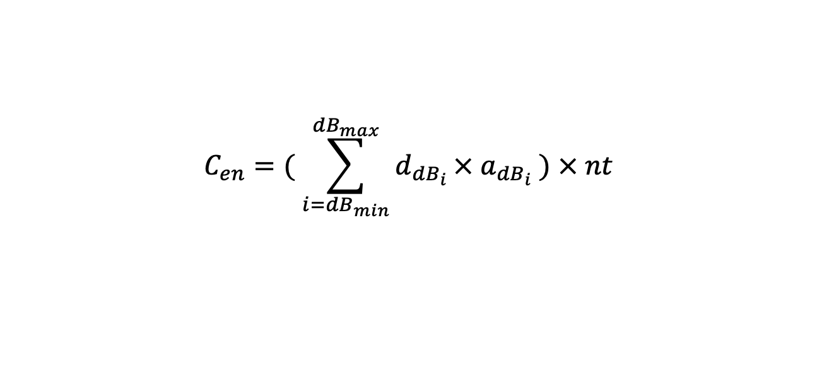
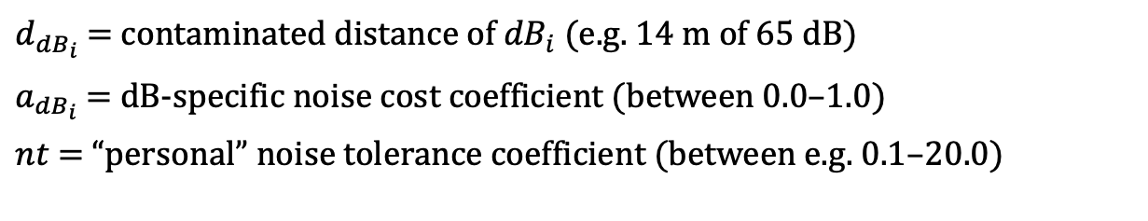
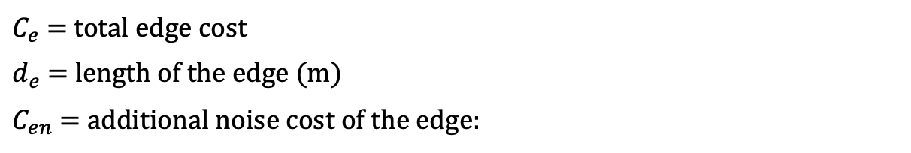
CALCULATING ADJUSTED EDGE COSTS
$$C_{e}=d_{e}+C_{en}$$
$C_{e}$ = total edge cost
$d_{e}$ = length of the edge (m)
$C_{en}$ = additional noise cost of the edge:
$$C_{en}=( \sum_{i={dB}_{min}}^{{dB}_{max}}{d_{{dB}_{i}}}× a_{{dB}_{i}} ) × nt$$
$d_{{dB}_{i}}$ = contaminated distance of ${dB}_{i}$ (e.g. 14 m of 65 dB)
$a_{{dB}_{i}}$ = dB-specific noise cost coefficient (between 0.0–1.0)
$nt$ = “personal” noise tolerance coefficient (between e.g. 0.1–20.0)

Slide 5
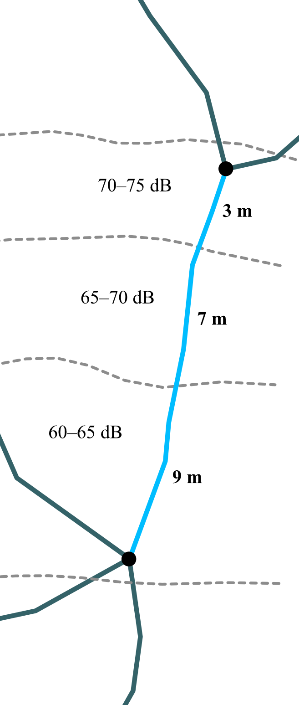
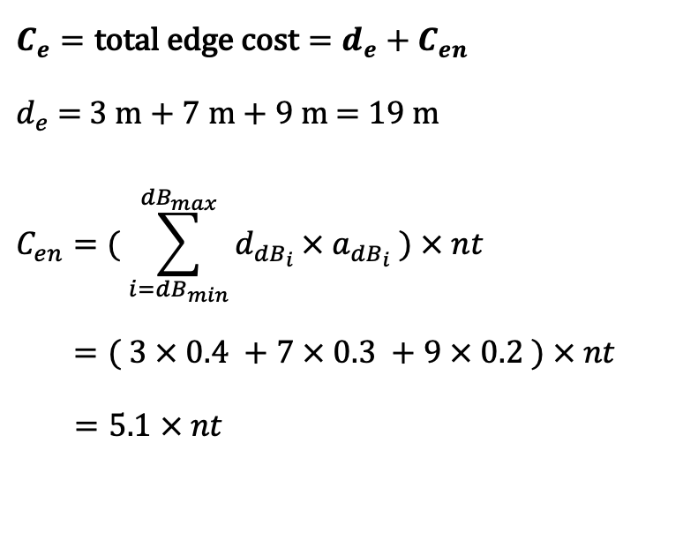
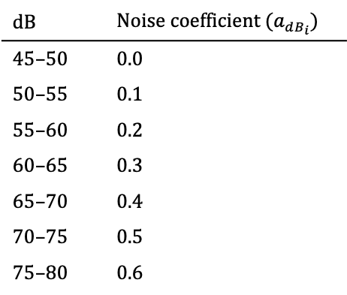
$$C_{e}=\text{total} \text{edge} \text{cost}=d_{e}+C_{en}$$
$d_{e}$ = 3 m + 7 m + 9 m = 19 m
$$C_{en}=( \sum_{i={dB}_{min}}^{{dB}_{max}}{d_{{dB}_{i}}}× a_{{dB}_{i}} ) × nt$$ $=( 3 × 0.4 +7 × 0.3 +9 × 0.2 ) × nt$
$=5.1 × nt$
dB | Noise coefficient ($a_{{dB}_{i}}$)
45–50 | 0.0
50–55 | 0.1
55–60 | 0.2
60–65 | 0.3
65–70 | 0.4
70–75 | 0.5
75–80 | 0.6

Slide 6
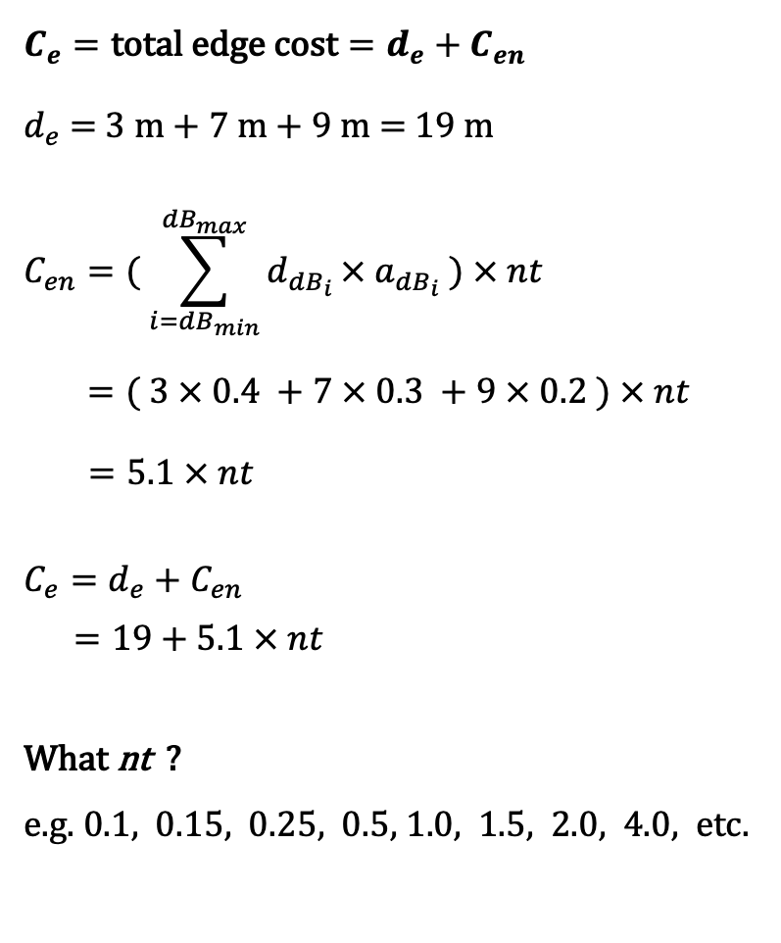
$$C_{e}=\text{total} \text{edge} \text{cost}=d_{e}+C_{en}$$
$d_{e}$ = 3 m + 7 m + 9 m = 19 m
$$C_{en}=( \sum_{i={dB}_{min}}^{{dB}_{max}}{d_{{dB}_{i}}}× a_{{dB}_{i}} ) × nt$$ $=( 3 × 0.4 +7 × 0.3 +9 × 0.2 ) × nt$
$=5.1 × nt$
$$C_{e}=d_{e}+C_{en}$$
$=19+5.1 × nt$
What nt ?
e.g. 0.1, 0.15, 0.25, 0.5, 1.0, 1.5, 2.0, 4.0, etc.

Slide 7
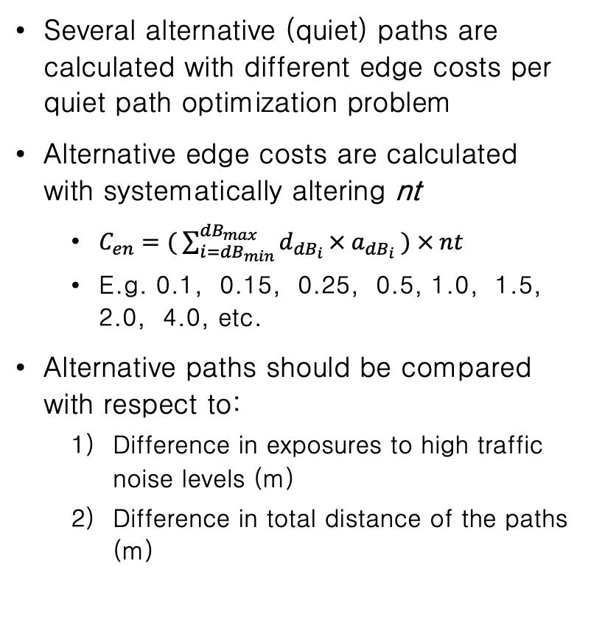
QUIET PATH OPTIMIZATION
Several alternative (quiet) paths are calculated with different edge costs per quiet path optimization problem
Alternative edge costs are calculated with systematically altering nt
$C_{en}=( \sum_{i={dB}_{min}}^{{dB}_{max}}{d_{{dB}_{i}}}× a_{{dB}_{i}} ) × nt$
E.g. 0.1, 0.15, 0.25, 0.5, 1.0, 1.5, 2.0, 4.0, etc.
Alternative paths should be compared with respect to:
Difference in exposures to high traffic noise levels (m)
Difference in total distance of the paths (m)

Slide 8
WHAT IS THE BEST PATH ?
Type | nt | Length (m) | Length diff (m) | Length diff (%) | Diff. >60 dB (m) | Diff. >70 dB (m)
short | 0 | 1764 | 0 | 0 | 0 | 0
quiet | 0,15–0,50 | 1794 | +30 | +1,7 | -659 | -302
quiet | 1,00–2,00 | 1830 | +66 | +3,7 | -675 | -395
quiet | 4,00–6,00 | 2123 | +358 | +20,3 | -937 | -398

Slide 9
WHAT IS THE BEST PATH ?
Type | nt | Length (m) | Length diff (m) | Length diff (%) | Diff. >60 dB (m) | Diff. >70 dB (m)
short | 0 | 1764 | 0 | 0 | 0 | 0
quiet | 0,15–0,50 | 1794 | +30 | +1,7 | -659 | -302
quiet | 1,00–2,00 | 1830 | +66 | +3,7 | -675 | -395
quiet | 4,00–6,00 | 2123 | +358 | +20,3 | -937 | -398

Slide 10
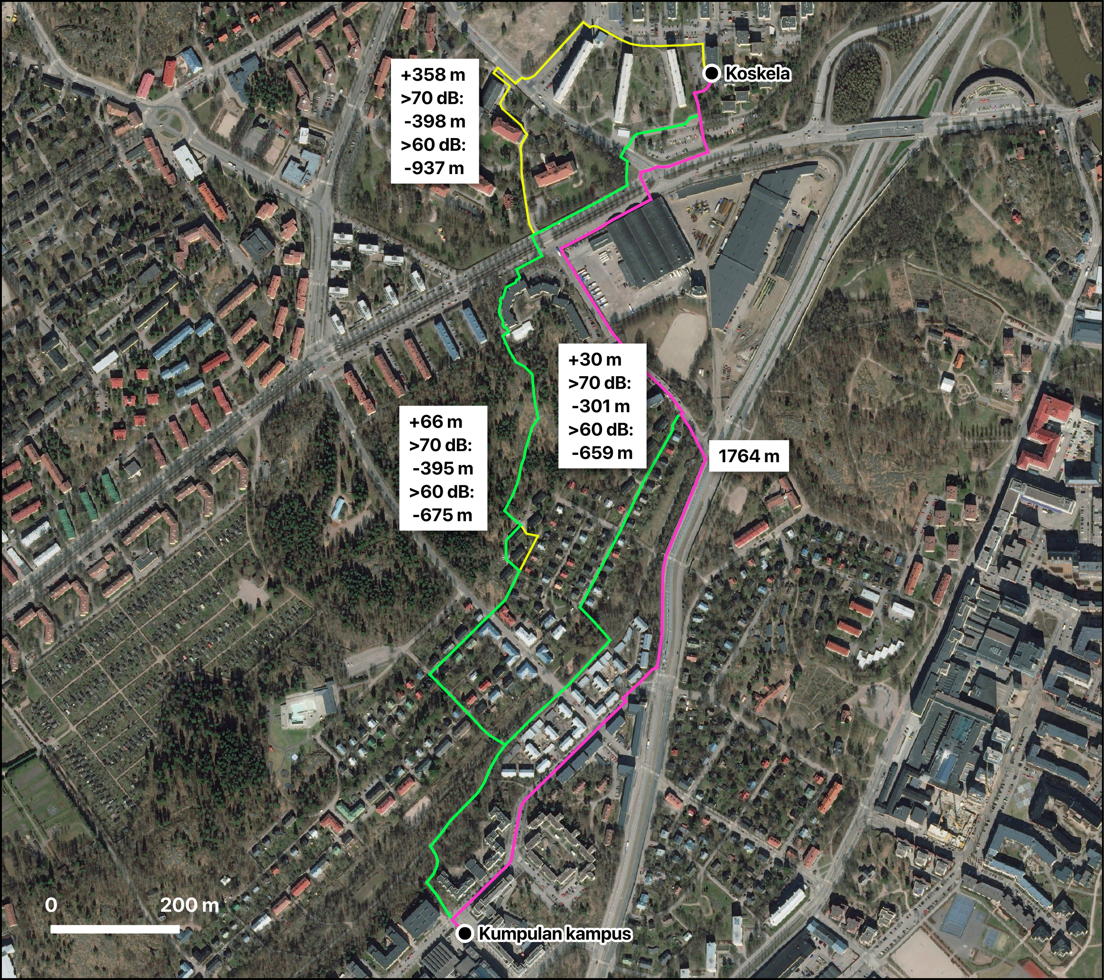

Slide 11
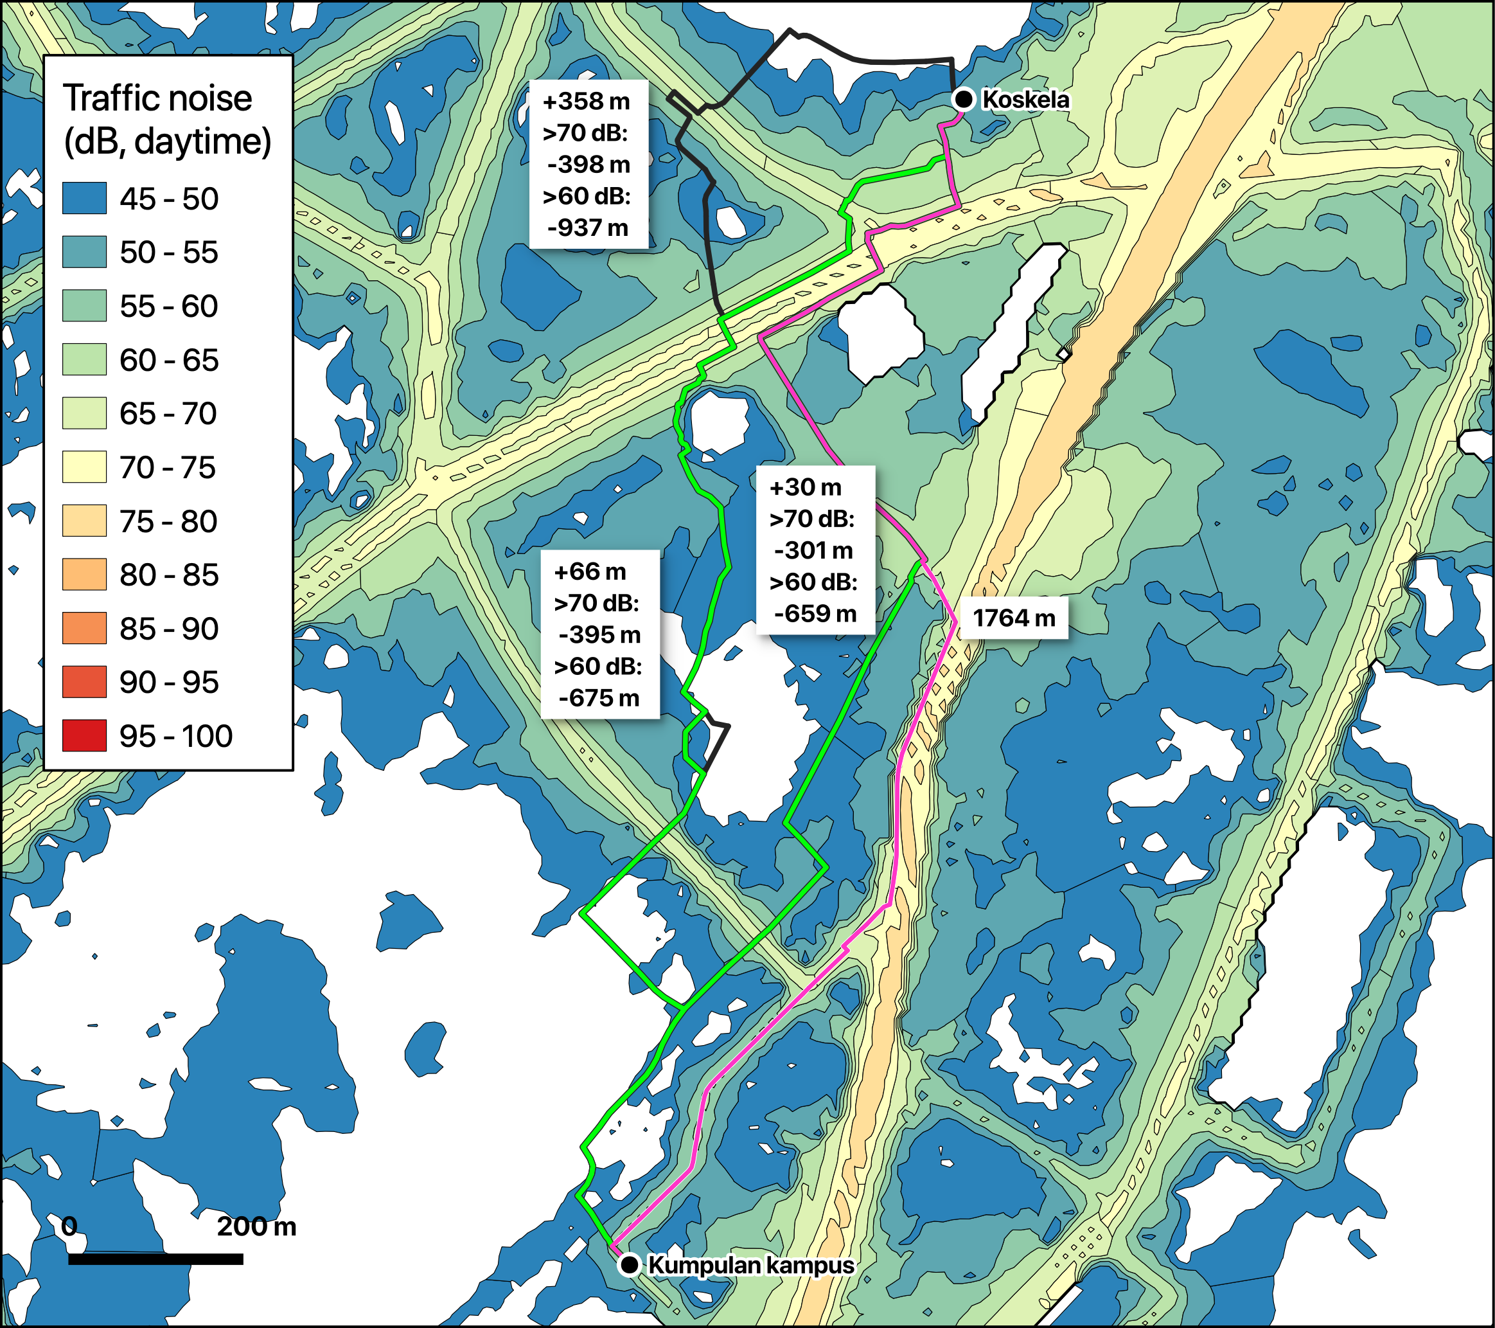

Slide 12
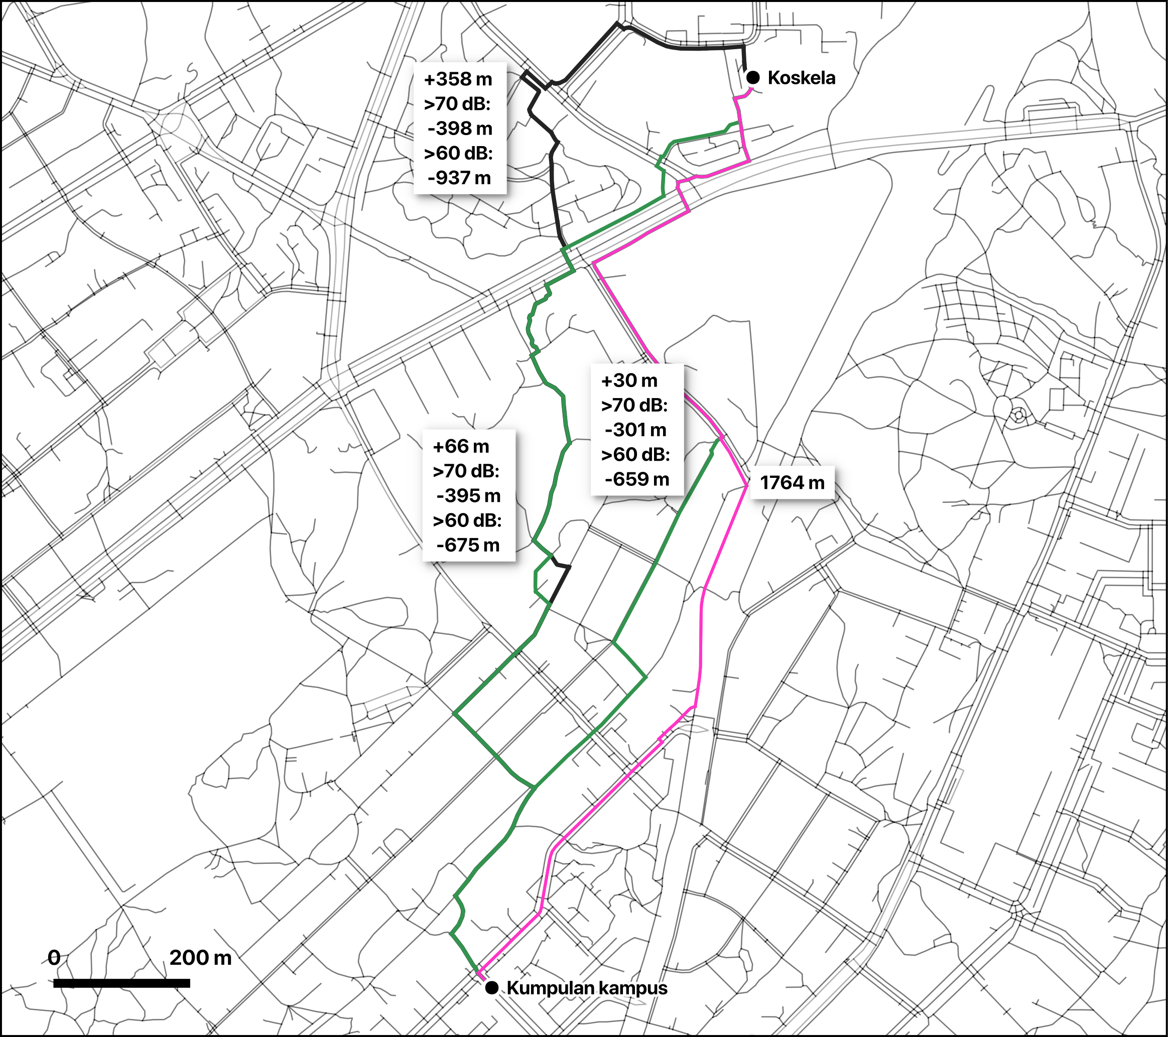

Slide 13
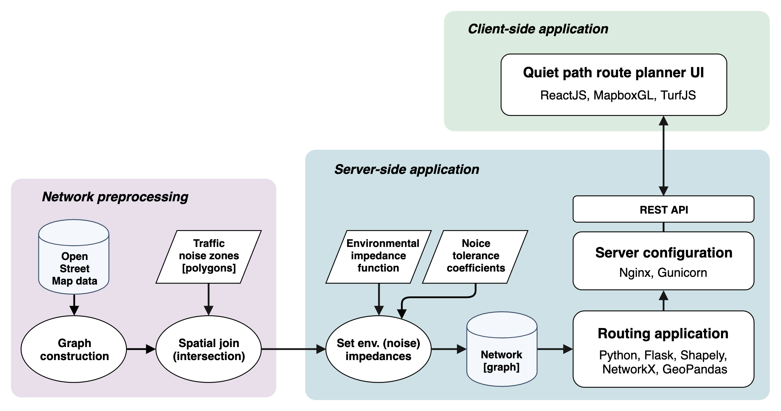
QUIET PATH PLANNER - WEB APPLICATION

Slide 14
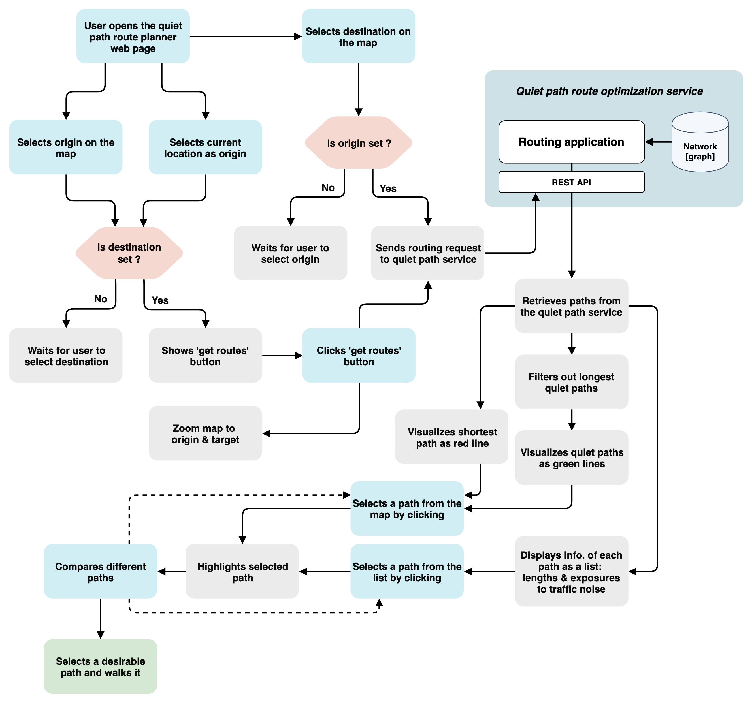
QUIET PATH PLANNER - WEB APPLICATION

